Slide 1
DRUG SALES ANALYSIS
P.BABY SUSHMA-248T1A4451

Slide 2
CONTENTS
. Abstract
. Introduction
. System Requirements
. Architecture
. Uses of data analysis libraries
. Advantages
. Conclusion

Slide 3
ABSTRACT
This project presents a comprehensive analysis of drug sales data using Python to extract meaningful insights from pharmaceutical records. The dataset consists of information related to drug names, drug groups, pharmacies, companies, doctors, patients, seasons, reporting status, and prescription details.
Python libraries such as Pandas, NumPy, and Matplotlib are used for data preprocessing, cleaning, filtering, grouping, sorting, statistical analysis, and visualization. Various analytical queries are performed to identify the most frequently prescribed drugs, leading pharmacies, seasonal drug demand, company performance, and reporting patterns.
The graphical representations help convert complex healthcare data into understandable visual insights, supporting better decision-making in pharmaceutical inventory management and sales analysis.

Slide 4
INTRODUCTION
Drug sales analysis is the process of examining pharmaceutical sales data to understand prescription trends, medicine demand, pharmacy performance, and healthcare distribution patterns.
Manual analysis of large pharmaceutical datasets is time-consuming and prone to errors. Python provides efficient tools for handling large datasets, cleaning inconsistent records, performing statistical analysis, and generating meaningful visualizations.
This project analyzes drug sales records using Python and presents the results through charts and analytical reports that help understand medicine usage patterns and business performance.

Slide 5
SOFTWARE REQUIREMENTS
Operating System : Windows 10 / Windows 11
Programming Language : Python
IDE : Jupyter Notebook
Libraries :
• Pandas
• NumPy
• Matplotlib
Dataset Format : CSV
HARDWARE REQUIREMENTS
Processor : Intel Core i3/i5/i7
RAM : Minimum 4 GB
Storage : Minimum 1 GB Free Space

Slide 6
ARCHITECTURE
The architecture of the Drug Sales Analysis using Python, Pandas, NumPy, and Matplotlib involves several key steps that transform raw pharmaceutical data into meaningful insights.
The process includes data import, data preprocessing, data analysis, statistical operations, and data visualization.
Let's explore the architecture in more detail:
IMPORTING DATASET
DATA EXPLORATION
DATA CLEANING
DATA FILTERING
DATA GROUPING
DATA SORTING
AGGREGATION FUNCTIONS
QUERY ANALYSIS
DATA VISUALIZATION

Slide 7

IMPORTING DATASET
The dataset is imported into Python using the Pandas library. The CSV file is loaded into a DataFrame for further analysis.

Slide 8
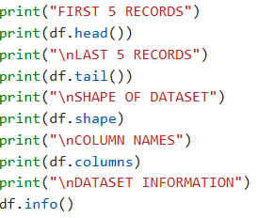
DATA EXPLORATION
Data exploration helps understand the structure, size, and quality of the dataset before analysis.

Slide 9
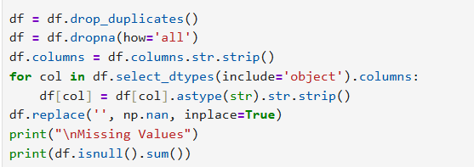
DATA CLEANING
Data cleaning removes inconsistencies and improves the quality of the dataset for accurate analysis.

Slide 10
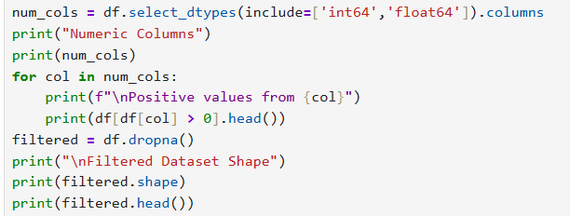
DATA FILTERING
Filtering is used to retrieve only the required records from the dataset based on specific conditions.

Slide 11
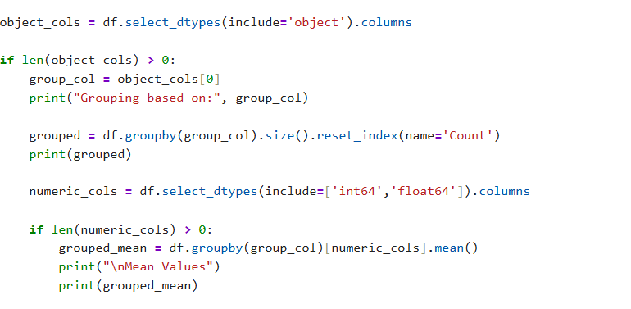
DATA GROUPING
Grouping combines records based on common attributes and calculates summary statistics.

Slide 12
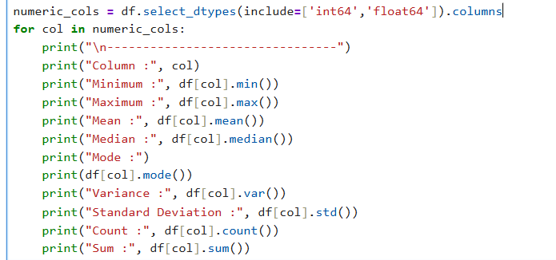
STATISTICAL ANALYSIS
Statistical analysis is performed to summarize and understand the numerical characteristics of the drug sales dataset. Various statistical measures are calculated to analyze data distribution and support meaningful decision-making.

Slide 13
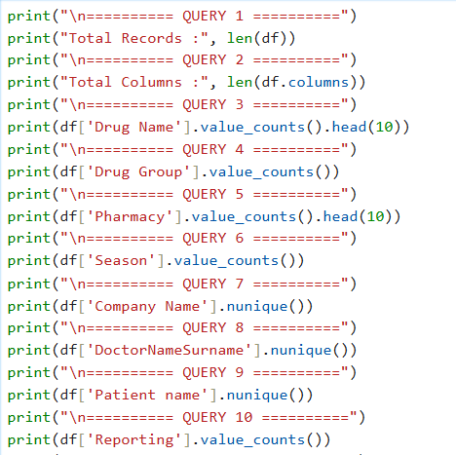
QUERY ANALYSIS
Query analysis is performed to extract meaningful insights from the drug sales dataset. Different queries are executed to identify the most prescribed drugs, drug groups, pharmacies, companies, doctors, patients, seasonal distribution, reporting status, and overall dataset statistics.

Slide 14
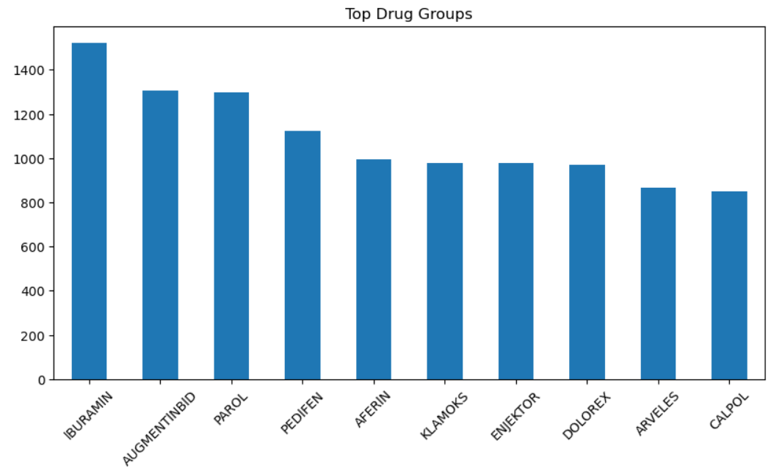
DATA VISUALIZATION
Data visualization is used to represent drug sales data in graphical form. It helps identify trends, compare categories, and understand the dataset more effectively using different types of charts.

Slide 15
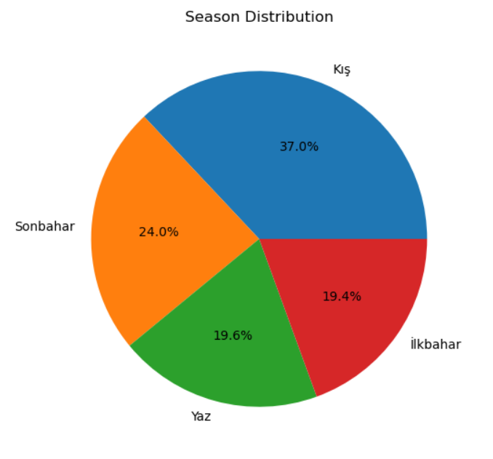
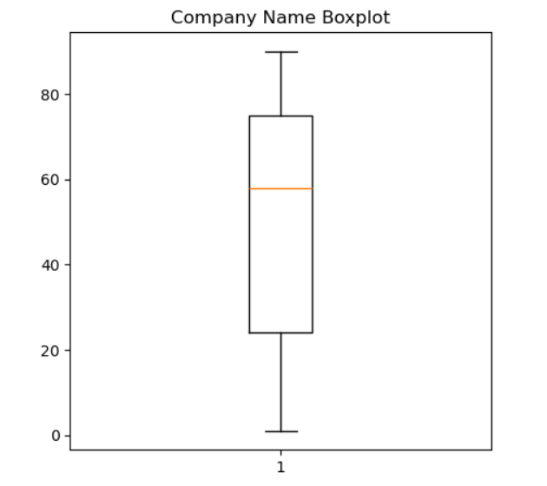
PIE CHART BOXPLOT

Slide 16
USES OF DATA ANALYSIS LIBRARIES
PANDAS
Used to read CSV files.
Performs data cleaning, filtering, grouping, and sorting.
Provides functions like head(), info(), and describe().
Main library for data manipulation and analysis.
NUMPY
Used for numerical and mathematical operations.
Handles missing values using NaN.
Performs statistical calculations efficiently.
Supports fast array and numerical processing.
MATPLOTLIB
Used to create charts and graphs.
Visualizes drug sales data clearly.
Supports bar charts, pie charts, histograms, and box plots.
Makes analytical results easy to understand.

Slide 17
ADVANTAGES
Makes large drug sales datasets easy to analyze.
Improves data accuracy through data cleaning.
Identifies drug sales trends and distribution patterns.
Provides meaningful insights using statistical analysis.
Presents data clearly through charts and graphs.
Supports better decision-making in pharmaceutical analysis.
Saves time compared to manual data analysis.
Useful for students, researchers, and healthcare organizations.

Slide 18
CONCLUSION
The project successfully demonstrates Drug Sales Analysis using Python.
Pandas was used for data cleaning, filtering, grouping, and analysis.
NumPy supported numerical and statistical calculations.
Matplotlib transformed the analyzed data into clear visualizations.
The analysis provided valuable insights into drug sales trends, pharmacies, companies, doctors, and seasonal distribution.
Overall, the project is useful for learning data analysis and supporting pharmaceutical decision-making.

Slide 19
THANK YOU !

